Slide 1
Hospital X Incident Report

Slide 2
THREAT SUMMARY
Summary of Situation: A new healthcare legislation was announced this morning that negatively impacts millions of patients around the world, and masses are outraged. Soon after the announcement, 3 different hospitals called A, B and C in our partner network were hit with ransomware attacks that shut down their entire operations. FBI believes that this is not the last in the string of hits. The hospitals disclosed that each incident started with a user in the technology department opening an email attachment resource. This activity has not yet been seen in Hospital X.
Asset: Personal documents and files of the centralized log management system, control systems used to monitor patient stats
Impact: Confidentiality, Integrity, Availability
Threat Actor:
FIN4 – Financially-motivated threat group that has targeted confidential information related to the public financial market, particularly regarding healthcare and pharmaceutical companies, since at least 2013.
External Threat – Cyber Criminal, Hacktivists
Insider Threat – Criminal, Oblivious, Third-party, Disgruntled, Terminated
Threat Actor Motivation: It’s likely an attack on hospitals in favor of new healthcare legislation for advanced political or social causes. It could be a financial attack disguised as a hacktivist. In case of Insider threat motivations, it could be diverse. It could be intentional or unintentional. Just by mistake or premediated for money or disgruntled employee clicked intentionally even they knew its suspicious.
Common Threat Actor Techniques
Intentional threats – Phishing, Spear phishing, Ransomware, Keylogger, Valid accounts
Unintentional threats – Using human error by social engineering security unaware employees to make them open email attachment which is malicious program or to gain passwords or credentials.

Slide 3
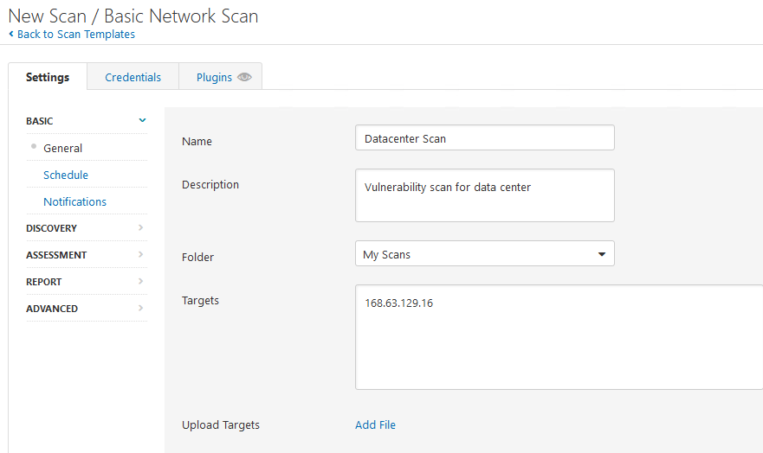
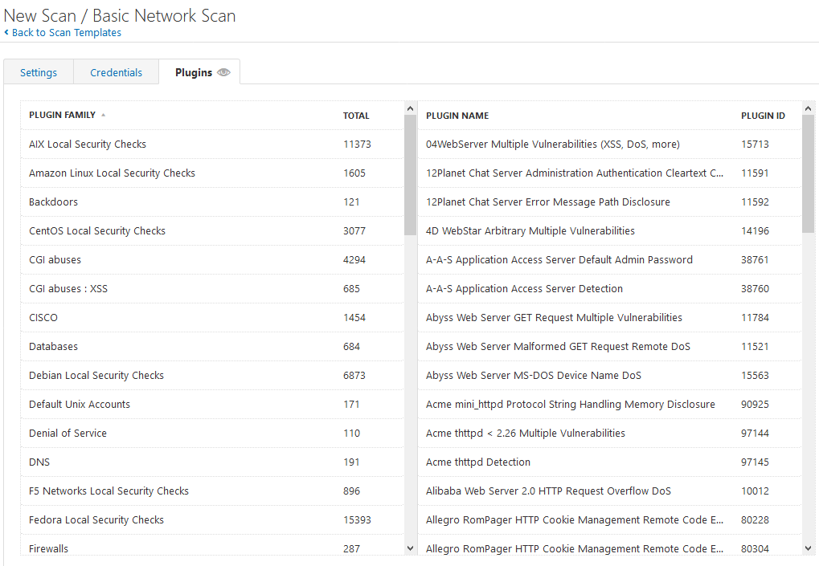
VULNERABILITY SCANNING TARGETS
Summary of scan targets:
Number of devices scanned: 1
Device type: VM(Virtual Machine)
Primary purpose of device: The device is used for data center that contain centralized log files and backups

Slide 4
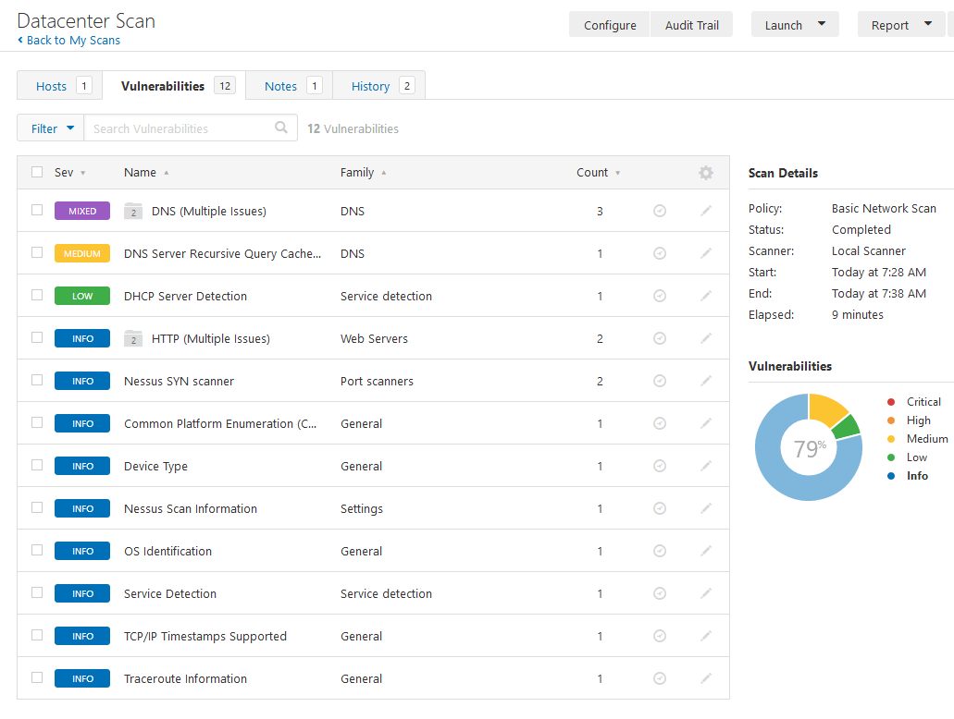
VULNERABILITY SCAN RESULTS
Summary of findings:
Total number of actionable findings: 12
Critical: 0
High: 0
Medium: 2
Low: 1

Slide 5
REMEDIATION RECOMMENDATION
Fix within 7 days
Finding | Severity Rating | Recommended Fix
No Critical or high vulnerabilities found
Fix within 30 days
Finding | Severity Rating | Recommended Fix
DNS Server Recursive Query Cache Poisoning Weakness | Medium | Restrict recursive queries to the hosts that should use this nameserver
DNS Server Spoofed Request Amplification DDoS | Medium | Restrict access to your DNS server from public network or reconfigure it to reject such queries
Fix within 60 days
Finding | Severity Rating | Recommended Fix
DHCP Server Detection | Low | Apply filtering to keep this information off the network and remove any options that are not in use

Slide 6
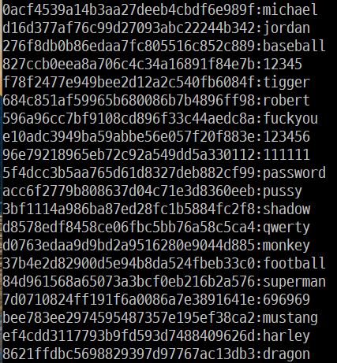
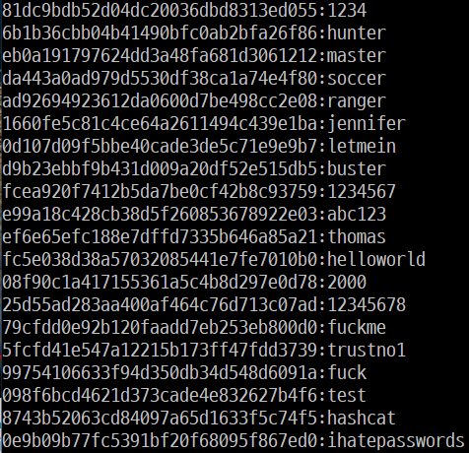
PASSWORD PENETRATION TEST OUTCOME
Methodology: Processed at WSL(Window subsystem for Linux). Hash information of passwords are placed in hashes.txt file. Downloaded cleartext passwords list called rockyou as txt file. Used hashcat.exe file to crack password hashes with options md5, straight attack type feeding rockyou.txt. Additionally used rule-based attack with the rule supported by hashcat program itself called rockyou-30000.rule.
Number of passwords tested: 40
Number of passwords cracked: 40
Evidence of weak passwords: All password has been cracked under 10 seconds. Using md5 hashing algorithm. Most of the passwords are under 10 characters.
Recommended steps to improve passwords security:
Use password more than 12 words
Use Upper / Lowercase letters, numbers, symbols both to make password hard to crack
Approximately with above it took 34k years to crack with combination of letter, numbers, symbols
Change password every 6 month
Use salt to prevent usage of rainbow table
Use more stronger hashing algorithm like sha256 to prevent hash collision as possible

Slide 7
INCIDENT RESPONSE PRELIMINARY ASSESSMENT
Summarize ongoing incident:
3 Hospitals A, B, and C were hit by Ransomware and now our hospital is contaminated by ransomware also and currently hackers are asking to pay one million dollars to access the system. The control systems used to monitor patient stats are no longer available through the standard user interface. Some doctors report being unable to render treatments because they cannot view detailed information about patient status. Log analysis tool is down, and security leader has declared this a critical security incident.
Document actions or notes from the following steps of the initial incident response checklist
Step 1: Several doctors, nurses, and administrative staff discovered the incident and contacted the help desk team for help.
Step 2: Indicators of compromise is very clear that log analysis systems, control system used to monitor patient stats are down, and already attacked by Ransomware. This potential impact is to lost all the personal documents and files of the centralized log management system; patient’s life might be threatened due to doctors are unable to render treatments. Currently control system and the data center that is used as centralized log management system is targeted. OS is window 10 pro, and the IP address is 52.251.118.221
Step 3: The incident type is ransomware and security leader has confirmed as critical security incident and its on progress. The response should be urgent. Not sure is there are alerts embedded in the ransomware but assumed that hackers would not mind decrypting as they seem confidence. They are sure we cannot decrypt without this ransomware and allowing to delete the software. It is unlikely that action will be taken from hackers when we try to decrypt it. So, we don’t care.

Slide 8
INCIDENT RESPONSE PRELIMINARY ASSESSMENT
Step 4: While the control system is down doctors are unable to render treatments because they cannot view detailed information about patient status. Potentially, emergency patients may be in a dangerous situation because they are not properly treated. IR team and staff has no issue with safety, but patients' life could be at immediate risk.
Step 5: All security team coordinate communications with necessary internal and external stakeholders. Doctor, nurse, staff, legal, IT support, media and PR, human resources team should know this situation immediately and plan to ensure the business continuity.
Step 6: This incident should be categorized to a “Threat to public safety or life” with the highest applicable level. Even this is ransomware so likely to categorize into “Threat to sensitive data” but this is including human life problem so it should be categorized into “Threat to public safety or life” to be able to be prioritized compared to other “Threat to sensitive data” problem.
Step 10: Incident is discovered by doctors, nurses, and administrative staff. It is intentional external threat which is ransomware, phishing, spear phishing, whaling. It happened by user opening an email attachment resource with is ransomware. Attack is coming from the group FIN4. They seem to be hacktivist unhappy with the hospital’s endorsement of the healthcare legislation or financially motivated attackers.

Slide 9
INCIDENT RESPONSE RECOMMENDED ACTION
Summarize recommendation to contain, eradicate, and recover:
Describe the overall recommended containment, eradication, and recovery plan
Eradication and recovering is the urgent thing because human life is at stake. Isolate the systems infected by ransomware, wipe them clean, and restore systems fully from backups. This will take time so in the meantime patients should be prioritized to select urgent patients. After that contact other hospital that might have the record of the urgent patient. If no records are possible re-check the patient as fast as possible.
Containment follows next. Ransomware response procedure should be added to Step 7 of checklist. System that checks Email attachment to detect malicious programs should be conducted. Also, education of security to all staff inside the hospital must be done to prevent oblivious insider threat.
Documented actions and notes from the IR checklist
Step 7: IR team should follow Ransomware response procedure. Team should recover from the incident by isolating the systems infected by the ransomware, wipe them clean, and restore systems fully from backups.
Step 8: Currently checking the logs for digital forensic is not possible. We need to investigate employees who opened emails infected with ransomware and find out if they are intentional and how this incident was caused.

Slide 10
INCIDENT RESPONSE RECOMMENDED ACTION
Step 9:
Malicious program detection system for email should be conducted.
Ensure there is a backup server isolated from network
Least privilege should be conducted for file permission. Modifying the files should be able by only special process for example by hospital’s specific program. In other case, the user won’t be able to modify the files, and this will prevent ransomware because even user execute the program the program won’t be able to encrypt the files due to permission.
Step 10: The response plan is to follow the checklist and recover the affected hospital’s system fast as possible. We will see this response plan is effective or not and will document every details after the incident is closed
Step 11: Preserve every emails and records and the logs which is encrypted currently. This evidence should be preserved and kept as long as necessary to complete prosecution and beyond in case of an appeal.
Step 12: Auto-backup system could be useful to prevent ransomware. The incident response was appropriate but currently there is no ransomware specific response plan so it could be good to add detailed plan for ransomware. Currently the recovery process is undergoing and need to talk about how could this be improved after the incident is closed. The changes of computer system side, human side should be made to prevent the re-infection. Mostly education of security to all staff inside the hospital must be done to prevent oblivious insider threat. Hospital systems are directly connected to the patient's life. We must make the main system more secure following least privilege, auto-updating patches, and auto-backup. We should strictly follow the security policy especially for the main server that affects the business continuity.

